Slide 1

Join algorithms including nested-loop, sort-merge and hash join
Database Management System | Storage Structures, Indexing and Query Optimization
Course: Database Management System (DBMS) | Chapter: Storage Structures, Indexing and Query Optimization | Program: B.TECH-CSE, B.TECH CSE - CYBER SECURITY, B.TECH CSE - DATA
DISCOVER · LEARN · EMPOWER
Notes:
Welcome everyone to this lecture on Join algorithms. We are focusing specifically on how databases physically combine data from different tables. This is a critical part of query optimization within our storage structures chapter. Let us begin by understanding the core outcomes of this session.

Slide 2
Course Outcomes
SLIDE 2 / 14
Course Outcome
CO | BT LEVEL | DESCRIPTION
CO1 | BT2 | Explain database architecture, relational model concepts and formal query language foundations including relational algebra and relational calculus.
CO2 | BT3 | Apply relational algebra, relational calculus and SQL constructs to formulate correct and efficient database queries.
CO3 | BT4 | Analyze functional dependencies and design normalized relational schemas up to 5NF ensuring lossless join and dependency preservation.
CO4 | BT4 | Analyze transaction schedules and concurrency control mechanisms to determine serializability, recoverability and correctness.
CO5 | BT5 | Evaluate storage structures, indexing strategies and query optimization techniques for performance, scalability and reliability.
Chandigarh University
2 / 14
Notes:
These two outcomes guide our entire discussion today. CO4 ensures we understand how joins fit into transaction correctness. CO5 is our primary focus, asking us to evaluate which join method offers the best performance and reliability for specific data sizes.

Slide 3
Learning Objectives
SLIDE 3 / 14
Learning Outcomes
1
Analyze the Nested-Loop Join algorithm and its computational complexity.
2
Evaluate the Sort-Merge Join strategy for handling sorted data inputs.
3
Assess the Hash Join mechanism for efficient equality joins on large datasets.
4
Compare the performance trade-offs between the three primary join algorithms.
5
Apply selection criteria to choose the optimal join method for a query.
Chandigarh University
3 / 14
Notes:
By the end of this lecture, you will be able to analyze the nested-loop approach and its limitations. You will evaluate how sorting data changes the join strategy entirely. We will also assess the hash join, which is often the fastest for large tables. Finally, you will learn to compare these methods to select the right one.

Slide 4
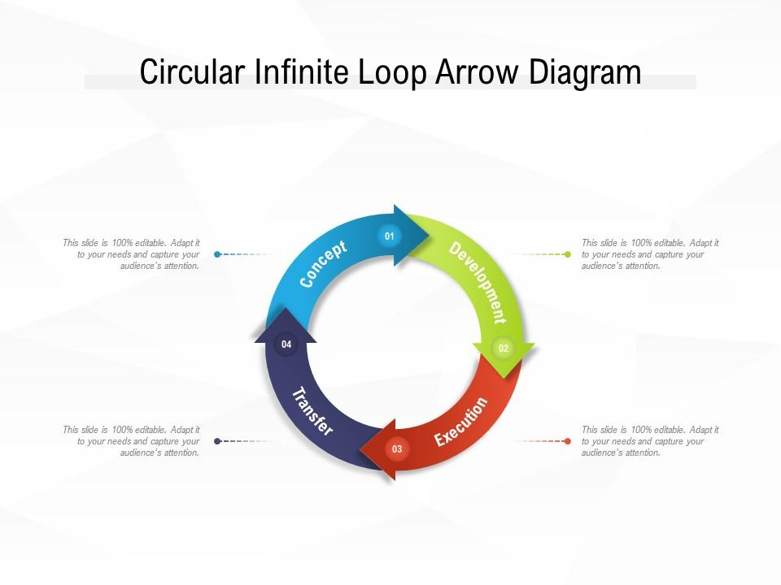
Lecture
SLIDE 4 / 14
Nested-Loop Join Fundamentals
1
The Nested-Loop Join iterates through every row of the outer table.
2
For each outer row, it scans every row of the inner table.
3
It compares the join condition for every possible pair of rows.
4
Basic complexity is O(n × m) where n and m are table sizes.
5
This method requires no pre-sorting or hashing of the input data.
6
It is the simplest algorithm but often the slowest for large tables.
7
Performance depends heavily on whether the inner table fits in memory.
Circular Infinite Loop Arrow Diagram | Graphics Presentation | Background for PowerPoint | PPT Designs | Slide Designs
Chandigarh University
4 / 14
Notes:
Think of the Nested-Loop Join like reading a phone book to find a match. You take one name from the list, then check every single other name against it. If you have 1000 rows in each table, you perform 1 million comparisons. This is why it is O(n × m) and often too slow for modern databases.

Slide 5
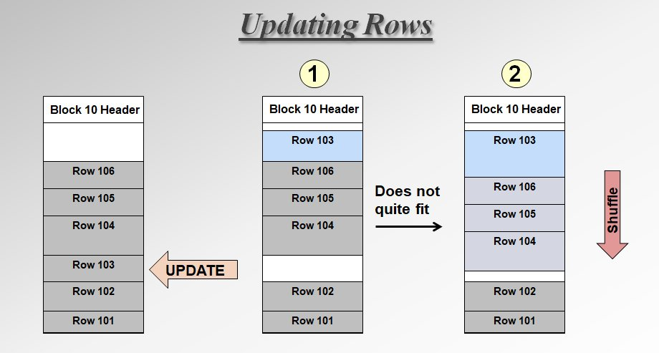
Lecture
SLIDE 5 / 14
Nested-Loop Join Optimization
1
Block Nested-Loop Join reads multiple rows of the inner table at once.
2
It uses available memory buffers to reduce disk I/O operations significantly.
3
Complexity improves to O(n + (n/b) × m) where b is buffer size.
4
The outer table is typically the smaller one to minimize iterations.
5
Index Nested-Loop Join uses an index on the inner table for lookups.
6
This reduces the inner scan from O(m) to O(log m) per outer row.
7
It is highly efficient when the join column is indexed and selective.
Source: mwidlake.wordpress.com
Chandigarh University
5 / 14
Notes:
We can optimize the basic nested loop by using Block Nested-Loop Join. Instead of reading one row at a time, we load a whole block of rows into memory. This drastically reduces the number of disk reads. If we also have an index, we can skip the full scan entirely, making it much faster.

Slide 6
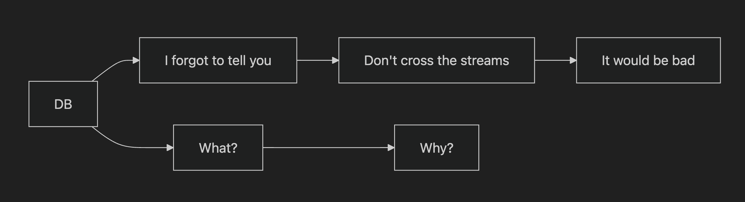
Lecture
SLIDE 6 / 14
Sort-Merge Join Mechanics
1
Sort-Merge Join requires both input tables to be sorted on the join key.
2
It performs a linear scan of both tables simultaneously after sorting.
3
Matching rows are identified by comparing the current keys of both streams.
4
The complexity is O(n log n + m log m) for sorting plus linear scan.
5
It is ideal when data is already sorted or when range joins are needed.
6
It handles duplicate keys naturally by outputting all matching combinations.
7
No additional memory structures like hash tables are required for the join.
Source: stack.convex.dev
Chandigarh University
6 / 14
Notes:
Imagine two sorted lists of names. You start at the top of both lists and compare them. If they match, you output the pair and move both pointers. If one is smaller, you move that pointer forward. The cost is mostly in the initial sorting, which is O(n log n). This makes it great for range queries.

Slide 7
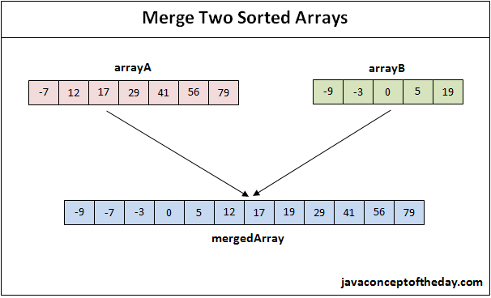
Lecture
SLIDE 7 / 14
Sort-Merge Join Example
TABLE A SORTED BY ID
10, 20, 30, 40, 50.
TABLE B SORTED BY ID
20, 30, 40, 50, 60.
ADVANCE BOTH POINTERS TO NEXT VALUES
30 and 30.
• Compare 10 (A) with 20 (B): 10 is smaller, advance A.
• Compare 20 (A) with 20 (B): Match found, output (20, 20).
• Compare 30 (A) with 30 (B): Match found, output (30, 30).
• Continue until one list is exhausted to complete the join.
Source: i0.wp.com
Chandigarh University
7 / 14
Notes:
Let's trace this numerically. We have Table A with IDs 10, 20, 30 and Table B with 20, 30, 40. We start at 10 and 20. Since 10 is less than 20, we skip 10. Now we compare 20 and 20. They match! We output the pair. We move to 30 and 30, which also match. This linear pass is very efficient once sorted.

Slide 8
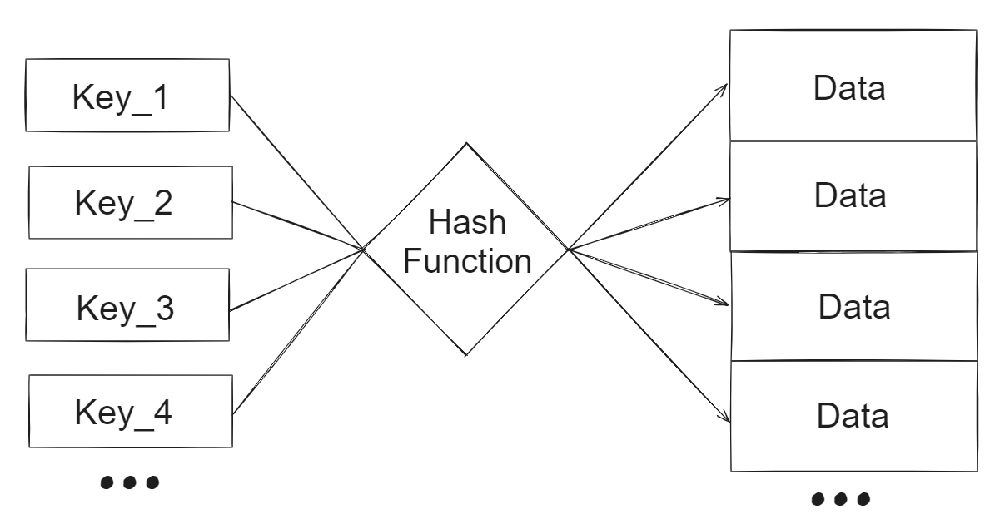
Lecture
SLIDE 8 / 14
Hash Join Fundamentals
1
Hash Join builds a hash table on the smaller table (build phase).
2
It probes the hash table with rows from the larger table (probe phase).
3
It uses a hash function to map join keys to specific bucket locations.
4
Complexity is O(n + m) assuming a good hash function and sufficient memory.
5
It is generally the fastest algorithm for large equality joins.
6
It requires no sorting of the input data before the join operation.
7
Performance degrades if hash collisions are frequent or memory is insufficient.
Source: abhinavpradeep.com
Chandigarh University
8 / 14
Notes:
The Hash Join is like looking up a word in a dictionary. You build a dictionary (hash table) from the smaller table. Then, for every word in the larger table, you look it up directly. This is O(n + m), which is linear and very fast. It is the standard choice for large equality joins in modern databases.

Slide 9
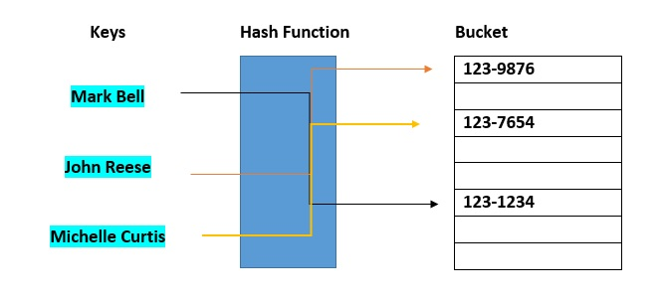
Lecture
SLIDE 9 / 14
Hash Join Numerical Example
GOVERNING EQUATION
Hash function: H(ID) = ID mod 3
BUILD PHASE
Hash Table on Table A (IDs: 10, 20, 30).
PROBE PHASE
Scan Table B (IDs: 20, 30, 40).
• Bucket 0: 30 (since 30 mod 3 = 0).
• Bucket 1: 10 (since 10 mod 3 = 1).
• Bucket 2: 20 (since 20 mod 3 = 2).
• Match 20: Hash(20)=2, check Bucket 2, find match.
Source: www.databricks.com
Chandigarh University
9 / 14
Notes:
Let's calculate the hash. If we use H(ID) = ID mod 3, then 10 goes to bucket 1, 20 to bucket 2, and 30 to bucket 0. Now we scan Table B. For ID 20, we calculate 20 mod 3 = 2. We go directly to bucket 2 and find the match. This direct access is why it is so fast.

Slide 10
Common Pitfalls
SLIDE 10 / 14
Nested-Loop
1
Using Nested-Loop on large tables without indexes causes severe slowdowns.
2
Selecting the larger table as the outer loop increases I/O operations.
3
Failing to use Block Nested-Loop wastes available memory buffers.
4
Ignoring existing indexes on the join column leads to full table scans.
5
Assuming constant performance regardless of data distribution is a major error.
6
Not considering the cost of disk I/O when estimating execution time.
7
Overlooking the benefit of Index Nested-Loop when indexes are available.
Chandigarh University
10 / 14
Notes:
A common pitfall is using the basic Nested-Loop on large tables. If you have 1 million rows, that is a trillion comparisons. You must always check if the inner table is indexed. If it is, use Index Nested-Loop. If not, consider other algorithms. Also, always put the smaller table on the outside to minimize iterations.

Slide 11
Common Pitfalls
SLIDE 11 / 14
Sort-Merge
1
Applying Sort-Merge when data is unsorted incurs high sorting overhead.
2
Ignoring the cost of sorting can make it slower than Nested-Loop.
3
Failing to handle duplicate keys correctly leads to missing results.
4
Using Sort-Merge for non-equality joins without proper range logic.
5
Not utilizing pre-sorted data when it is already available in storage.
6
Assuming sorting is free when it requires significant CPU and I/O.
7
Overlooking that Sort-Merge is the only choice for range joins.
Chandigarh University
11 / 14
Notes:
The biggest pitfall here is sorting data that is already small or unsorted. Sorting takes O(n log n), which can be expensive. If the tables are already sorted, Sort-Merge is great. But if you have to sort them first, you might be better off with a Hash Join. Also, ensure you handle duplicates correctly.

Slide 12
Common Pitfalls
SLIDE 12 / 14
Hash Join
1
Hash Join fails if the build table does not fit in available memory.
2
Poor hash functions cause collisions, degrading performance to O(n²).
3
Using Hash Join for range queries is incorrect as it requires equality.
4
Ignoring the cost of building the hash table for very small tables.
5
Not handling null values correctly in the hash function logic.
6
Assuming uniform data distribution when data is skewed across buckets.
7
Failing to spill to disk when memory is insufficient for the hash table.
Chandigarh University
12 / 14
Notes:
Hash Join has a critical constraint: the build table must fit in memory. If it doesn't, the database spills to disk, which is slow. Also, if your data is skewed, many rows might go into one bucket, causing collisions. This degrades performance to O(n²). Always ensure your hash function distributes data evenly.

Slide 13
Lecture
SLIDE 13 / 14
Key Takeaways
1
Nested-Loop is simple but slow O(n×m) unless optimized with indexes.
2
Sort-Merge is efficient for sorted data or range joins with O(n log n).
3
Hash Join is fastest for large equality joins with O(n + m) complexity.
4
Select the algorithm based on data size, memory, and existing indexes.
5
Query optimizers automatically choose the best join strategy for execution.
Chandigarh University
13 / 14
Notes:
To summarize, Nested-Loop is simple but slow without indexes. Sort-Merge is great if data is already sorted or for range queries. Hash Join is the fastest for large equality joins. Always consider your data size and memory when choosing. Modern optimizers will pick the best one, but you must understand the trade-offs.

Slide 14
Lecture
SLIDE 14 / 14
References
1
Fundamentals of Database Systems — Ramez Elmasri & Shamkant B. Navathe
2
Database System Concepts — Silberschatz, Korth & Sudarshan
3
Database Management Systems — Raghu Ramakrishnan & Johannes Gehrke
4
Oracle/MySQL Documentation — Oracle
Chandigarh University
14 / 14
Notes:
These are the standard textbooks and documentation we recommend for further study. Elmasri and Navathe provide a deep theoretical foundation. Silberschatz offers excellent practical examples. Ramakrishnan covers optimization in great detail. Finally, the Oracle and MySQL documentation provides specific implementation details for these algorithms.

